Slide 1




PHP Flow Control
Loops, Functions, Return, Exit, Require, Try...Catch
SoftUni Team
Technical Trainers
Software University
http://softuni.bg

Slide 2

Table of Contents
Loops
While, Do…While, For, Foreach
Functions, Return and Exit
Variable Scope
Include and Require
Exception Handling

Slide 3
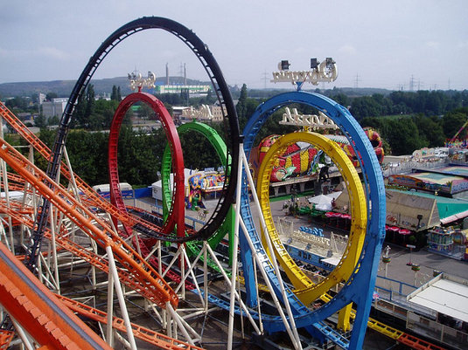
Loops

Slide 4
While Loop
While loops are the simplest type of loop in PHP
Repeat a block of code while a certain condition is true:
The body consists of one or more statements
If more than one, surrounding brackets are required
The condition expression is of type boolean
while (expr) {
statement;
}
while (expr):
statement;
endwhile;

Slide 5
While Loop – Example
Printing the numbers from 1 to 10:
<?php
$counter = 1;
while ($counter <= 10) {
echo "<p>$counter</p>";
$counter++;
}
?>

Slide 6
While Loop – Alternative Syntax
While loops have alternative syntax, without { }
Printing the Unicode characters from &#0; to &#5000;
<?php
$charCode = 0;
while ($charCode <= 5000) : ?>
<div style="display: inline-block; width:80px">
<?= $charCode++ ?> -> &#<?=$charCode?>;
</div>
<?php endwhile; ?>

Slide 7
Do { … } While()
Do-while loops repeat a code block until some condition breaks
The loop expression is checked at the end of each iteration
The loop body executes at least once
<?php
$i = 10;
do {
echo $i . "\n"; // prints 10, 9, 8, …, 0
$i--;
} while ($i > 0);
?>

Slide 8

While Loops
Live Demo

Slide 9
For Loops
The classical for-loop syntax is:
Consists of
Initialization statement
Boolean test expression
Update statement
Loop body block
for (initialization; test; update) { statements; }

Slide 10
For Loop – Examples
A simple for-loop to print the numbers 0...9:
for ($number = 0; $number < 10; $number++) {
echo $number . " ";
}
A simple for-loop to calculate n!:
$n = 5; $factorial = 1;
for ($i = 1; $i <= $n; $i++) {
$factorial *= $i;
}

Slide 11
For-Loop – Alternative Syntax
Printing blocks of different colors:
<?php
for ($r=0, $g=0, $b=0; $r < 256; $r+=16, $g+=8, $b+=4) :
$color = "#" .
str_pad(dechex($r), 2, '0') .
str_pad(dechex($g), 2, '0') .
str_pad(dechex($b), 2, '0');
?>
<div style="width:400px; background-color:<?=$color?>">
<?=$color?>
</div>
<?php endfor; ?>

Slide 12

For-Loops
Live Demo

Slide 13
Foreach
The foreach construct iterates over arrays and objects
Iterate over the values in array:
Iterate over the key-value pairs in associative array:
foreach (array_expression as $value) {
statements;
}
foreach (array_expression as $key => $value) {
statements;
}

Slide 14
Foreach – Examples
$colors = array("red", "green", "blue", "yellow", "orange");
foreach ($colors as $value) {
echo "$value <br>";
}
$colorMap = array(
"red" => "#F00", "green" => "#0F0", "blue" => "#00F");
foreach ($colorMap as $key => $value) {
echo "<p>$key -> $value</p>";
}

Slide 15
Foreach – Alternative Syntax
Iterating over object properties:
<?php
$colors = (object)[];
$colors->red = "#F00";
$colors->slateblue = "#6A5ACD";
$colors->orange = "#FFA500";
foreach ($colors as $key => $value) : ?>
<p style="background-color:<?=$value?>">
<?=$key?> -> <?=$value?>
</p>
<?php endforeach ?>

Slide 16

Foreach
Live Demo

Slide 17

Functions

Slide 18
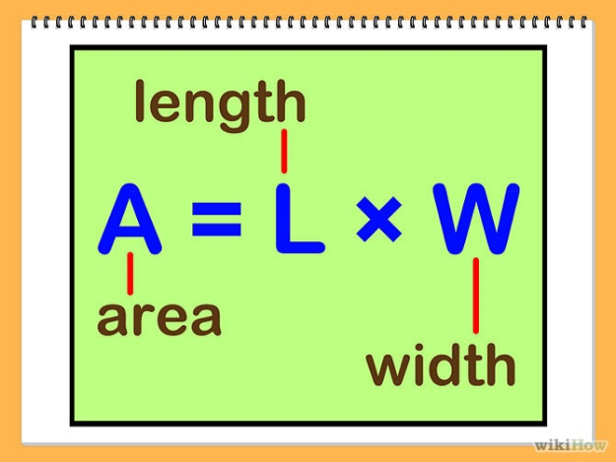
Functions
Functions are named blocks of code
Declared with the keyword function
Can accept parameters and return value
Help organize and reuse the code
function rectangleArea($sideA, $sideB) {
return $sideA * $sideB;
}
echo rectangleArea(5, 6);

Slide 19
Default Parameter Values
function strIsEqual($str1, $str2, $ignoreCase = true) {
if ($ignoreCase)
return strtolower($str1) == strtolower($str2);
else
return $str1 == $str2;
}
echo strIsEqual("nakov", "NaKOv", true); // 1 (true)
echo strIsEqual("nakov", "NAKOV"); // 1 (true)
echo strIsEqual("nakov", "Nakov", false); // "" (false)

Slide 20
Functions Parameters: Pass by Reference
By default PHP passes arguments to functions by value
Changed arguments in the function will be lost after it ends
To force pass by reference use the & prefix
function changeValue(&$arg) {
$arg += 100;
}
$num = 2;
echo $num . "\n"; // 2
changeValue($num);
echo $num; // 102

Slide 21
Variable Number of Arguments
PHP supports variable-length function arguments
Read the arguments: func_num_args() and func_get_args()
function calcSum() {
$sum = 0;
foreach (func_get_args() as $arg) {
$sum += $arg;
}
return $sum;
}
echo calcSum(1, 2), '<br />'; // 3
echo calcSum(10, 20, 30), '<br />'; // 60
echo calcSum(10, 22, 0.5, 0.75, 12.50), '<br />'; // 45.75

Slide 22
Returning Values from a Function
Functions can return values with the return statement
Accepts only one argument – the value to be returned
Exits the function
To return multiple values you can use arrays
It’s not obligatory for a function to return a value
function example($arg) {
return true;
// The following code will NOT be executed
echo $arg + 1;
}

Slide 23
Returning Multiple Values from a Function
You can use fixed-size arrays to return multiple values
The list keyword assigns multiple variables from array items
list is NOT a function, but a language construct
Works only for numerical arrays and assumes indexes start at 0
function smallNumbers() {
return [0, 1, 2];
}
list($a, $b, $c) = smallNumbers();
echo "\$a = $a; \$b = $b; \$c = $c";

Slide 24
Variable Functions
PHP supports variables holding a function
The function name is stored as string value
Can be invoked through the () operator
function printSomething($arg) {
echo "This is function. Arg = $arg";
}
$a = 'printSomething';
$a(5); // This invokes the printSomething(5) function

Slide 25
Few Notes on Functions
You can check if function is declared with function_exists($name)
Functions can be nested (declared inside other functions)
Once the first function is called, the second gets globally defined
if (!function_exists('func')) {
function func($arg) { return true; }
}
function first($args) {
function second($args) { … }
second('hello');
}

Slide 26
Anonymous Functions
Anonymous functions are inline functions with no name
Implemented by closures
$array = array("Team building: 6-7 September 2014, Pirin", "Nakov", "studying programming", "SoftUni");
usort($array, function($a, $b) {
return strlen($a) - strlen($b);
});
print_r($array);

Slide 27

Functions
Live Demo

Slide 28
Exit
The exit statement ends the PHP script execution immediately
Used for fatal errors, e.g. missing file / resource / database
If the statement is a number, it returns the exit code of the process
If it is a string, the value is printed before the process terminates
<?php
$filename = '/path/to/data-file';
$file = fopen($filename, 'r')
or exit("Unable to open file: $filename");
?>

Slide 29
Die
The function die() is an alias for the exit statement:
The message is required
The die() function prints a message and exits the current script:
die(message);
$db = mysql_connect("localhost", $username, $password);
if (!$db) {
die("Could not connect to database");
}

Slide 30

Exit
Live Demo

Slide 31

Variables Scope

Slide 32
Variables Scope
The arrays $_GET, $_POST, $_SERVER , $_REQUEST and other built-in variables are global
Can be accessed at any place in the code
Variables, declared in functions
Exist only until the end of function (local function scope)
Files being included inherit the variable scope of the caller
Variables declared outside of a function are not accessible in it
$name = $_GET['firstName'] . $_GET['lastName'];

Slide 33
The Global Keyword
Variables outside of a function are not accessible in it:
To access an external variable use the global keyword
$a = "test"; // global scope
function foo() {
echo $a; // this will not output anything (local scope)
}
foo();
$a = "test";
function foo() {
global $a; // the global variable $a is included in the scope
echo $a; // this will output "test"; }
foo();

Slide 34
Loops and Variable Scope
Variables, declared in loops are accessible after the loop ends
A variable in PHP is declared with its first assignment
for ($i = 0; $i < 5; $i++) {
$arr[] = $i;
}
print_r($arr); // outputs 0, 1, 2, 3, 4
$a = 15;
if ($a == 5) $five = 'five';
else $five = 'not five';
echo $five; // not five

Slide 35
Static Keyword
Static variables in PHP are initialized only once (on demand)
Their existing values are preserved in the next function calls
function callMe() {
static $count = 0; // initialized at the first call
$count++; // executed at each function call
echo "callMe() is called $count times\n";
}
callMe(); // callMe() is called 1 times
callMe(); // callMe() is called 2 times

Slide 36
Closures
A closure is an anonymous function that can access variables imported from its outside scope (closed in its environment)
function nextNumber() {
$counter = 0; // the $counter variable gets closed
return function() use (&$counter) {
return ++$counter;
};
}
$f = nextNumber();
echo $f() . "\n"; // 1
echo $f() . "\n"; // 2
echo $f() . "\n"; // 3

Slide 37

Include and Require
Including a Script from Another Script

Slide 38

Include and Require
include and require load and evaluate a file holding PHP code
Useful to structure and reuse the code
Both accept single parameter – a file name
Difference between include and require:
If file is not found include produces a warning
require produces a fatal error
require "header.php";
echo "page body comes here";
include "footer.php";

Slide 39
include_once and require_once
With include and require you can include one file many times and each time it is evaluated
With include_once and require_once if file is already included, nothing happens
For instance if in the file you have declared a function, double including will produce error "Function with same name already exists"
Example:
require_once "functions.php";

Slide 40
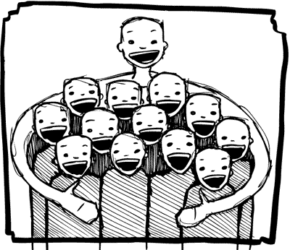
Include and Require
Live Demo

Slide 41

Exception Handling
Catch and Throw Exceptions

Slide 42
Exception Handling in PHP
Exception handling is used to change the normal code execution flow if an certain error (exceptional condition) occurs
When an exception is thrown
The code following it will not be executed
PHP will try to find the matching "catch" block
If an exception is not caught
A fatal error will be issued with an "Uncaught Exception" message
PHP supports the exception handling paradigm
But its API used the old procedural approach

Slide 43
Throwing Exceptions
To throw an exception, use the throw keyword
Exceptions cause a fatal error
But can be caught and handled to do something else
<?php
if (!file_exists("../include/settings.ini")) {
throw new Exception("Could not load settings.");
}
?>

Slide 44
Catching (Handling) Exceptions
PHP supports the classical try-catch-finally statement:
try {
$db = new PDO('mysql:host=localhost;dbname=test');
// If exception is thrown, the catch block is executed
}
catch (Exception $e) {
// Display the exception’s message
echo "Error: " . $e->getMessage();
}
finally {
echo "This code is always executed.";
}

Slide 45

Exception Handling
Live Demo

Slide 46


Summary
PHP supports the classical loop statements
While, do…while, for, foreach
PHP code may define and invoke functions
Functions may take parameters and return value
Including PHP code in another PHP code
include / include_once / require / require_once
Variable scope: local, global and static
PHP supports try-catch-finally
PHP Basics

Slide 47







PHP Flow Control
https://softuni.bg/courses/php-basics/

Slide 48
License
This course (slides, examples, demos, videos, homework, etc.) is licensed under the "Creative Commons Attribution-NonCommercial-ShareAlike 4.0 International" license
Attribution: this work may contain portions from
"PHP Manual" by The PHP Group under CC-BY license
"PHP and MySQL Web Development" course by Telerik Academy under CC-BY-NC-SA license

Slide 49




Free Trainings @ Software University
Software University Foundation – softuni.org
Software University – High-Quality Education, Profession and Job for Software Developers
softuni.bg
Software University @ Facebook
facebook.com/SoftwareUniversity
Software University @ YouTube
youtube.com/SoftwareUniversity
Software University Forums – forum.softuni.bg

